Slide 1
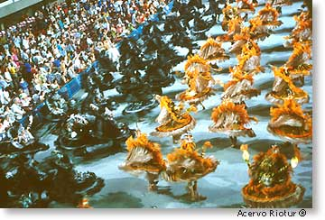
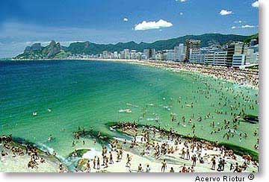
Problem Scenario:
Taking a Vacation
Andrea Pontes A00692239
Spencer Kamp A00653431
Erwin Majadillas A00693448
Biljana Kuzmanoska A00662939

Slide 2
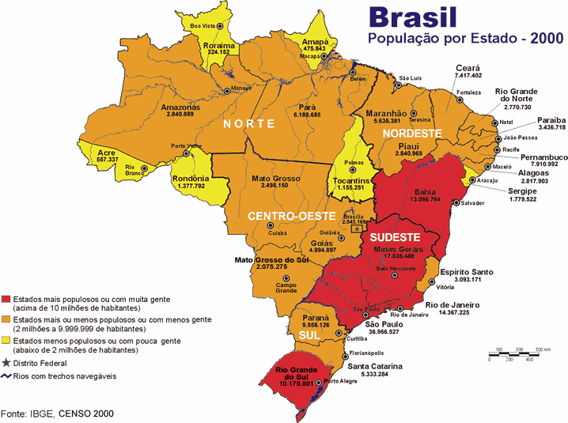
Vacation in Rio de Janeiro - Brasil
Language:
Portuguese
Size:
Almost same as Canada
Legend:
Red: 10+million people
Orange: 2-10 million people
Yellow: less 2 million people

Slide 3
Scope Definition
An opportunity to take vacation in Rio de Janeiro to visit tourist attractions and taste typical Brazilian food.
  http://www.rio.rj.gov.br/
Preliminary requirements and constraints
  Time off work is restricted to 3 weeks
  Carnival in Rio the Janeiro is in the month February
  Budget can not be increased
Budget
  CAD$ 5,000.00 (for each person)
Schedule
  Carnival time: from Feb 7th to Feb 28th, 2008

Slide 4
Problem Analysis
TIME OFF FROM WORK | Absolutely required that the all participants are able to take time off work during the period Acceptable that the schedule is shifted up to 1 week in to match all participants agenda
BUDGET | Total budget is CAD$ 20,000.00 and cannot be increased
CANCELLATION | If scope and budget cannot be met, this project needs to be postponed until February 2009
RISKS | Group agrees that all participants will not use or wear any valuable items during the trip, specially when outdoors Selected hotel needs to have specialized security staff for tourist support

Slide 5
Requirement Analysis
Stay in Rio de Janeiro (8d), stay in Búzios (4d), stay in Teresópolis for (4d) and stay in Paraty for (4d). From Apr 7th to Apr 27^{th.}
Go to Iemanjá restaurant in, Belmonte restaurant in Ipanema and Acarajé das Estrelas restaurant in Barra da Tijuca.
Go to the following Brazilian barbecue restaurants: Porcão in Barra da Tijuca and Oasis in São Conrado.
Go to Copacabana beach and play beach volleyball.
Go dance samba in the School of Samba in Salgueiro and Mangueira. Both stay in North Zone of Rio de Janeiro and an booking is required.
Final scope and requirements must be signed off within 6 months of the scheduled departure.
Flight category should be economic. Preferably use American Airlines or United Airlines.
Hotel should be located in Ipanema or Leblon.

Slide 6
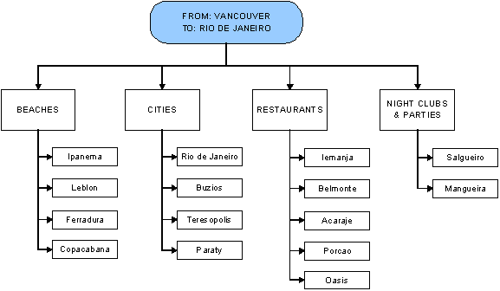
Logical Design

Slide 7
Decision Analysis
TRAVEL AGENCY | Technical feasibility: agent is responsible for making all reservation. Operational feasibility: agent will be responsible for reservations: flight, hotel, restaurants and attractions. Economic feasibility: agent’s operational costs should not exceed 5 (five) percent of the project budget. Schedule feasibility: agent will have up to 15 days to present initial vacation plan and costs, and up to 30 days after logical design sign off to complete all reservations. Risk feasibility: the associated costs might exceed defined budget and, eventually, the scope should be reviewed and agreed by all participants.

Slide 8
Decision Analysis (cont’d)
EXPEDIA.COM | Technical feasibility: one of the participants should complete all reservations. Operational feasibility: only flight and hotel reservations can be included in Expedia.com. Economic feasibility: the associated cost of this solution will probably be less than the one using a professional Travel Agent but will not include the added value of restaurant and attractions reservation performed by specialized travel agents. Schedule feasibility: dedicate at least 2 (two) hours per week, in the period of the maximum 6 weeks, to complete all reservations for this project. Risk feasibility: reservations might not have the best hotels and attractions chosen.
Preferred

Slide 9
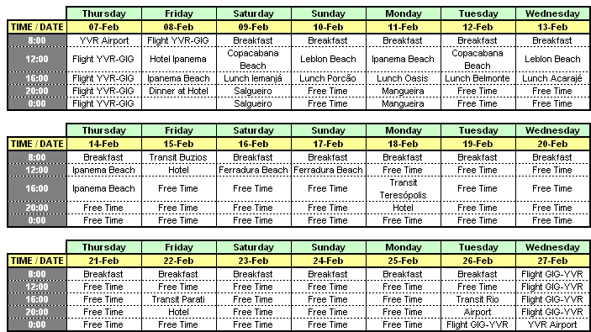
Physical Design

Slide 10

Construction and Testing
Item | Cost | Avg per Person
Flight (roundtrip) + Hotel Ipanema | $10,980.88 | $2,745.22
Hotel Búzios | $640.00 | $160.00
Hotel Teresópolis | $460.00 | $115.00
Hotel Paraty | $1,065.60 | $266.40
Night Shows | $1,200.00 | $300.00
Porcão | $132.00 | $33.00
Oásis | $132.00 | $33.00
Belmonte | $160.00 | $40.00
Iemanjá | $160.00 | $40.00
Acarajé | $160.00 | $40.00
Vans | $300.00 | $75.00
Preliminary Budget | $15,390.48 | $3,847.62

Slide 11
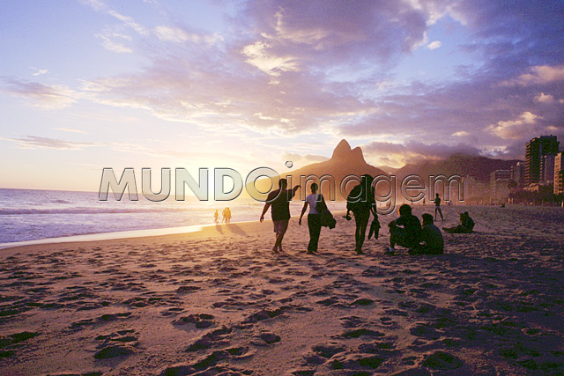
Let’s GO !!!

